Slide 1
Chainsaw Parts

Slide 2
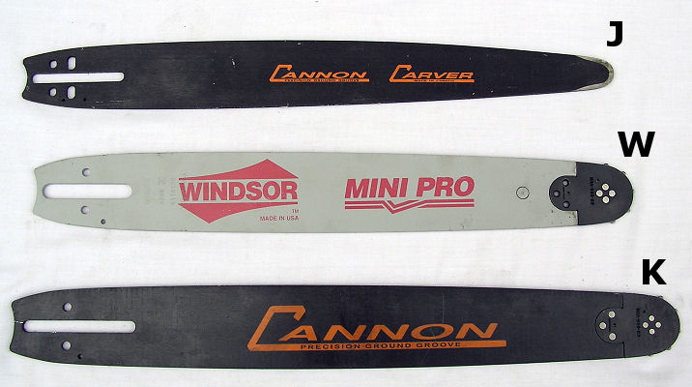
Bar

Slide 3
Bar Cover

Slide 4
Sawchain

Slide 5
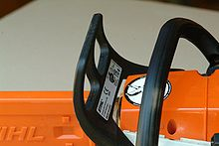
Chain Brake

Slide 6
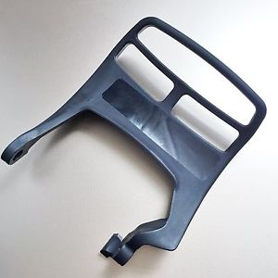
Front Hand Guard

Slide 7
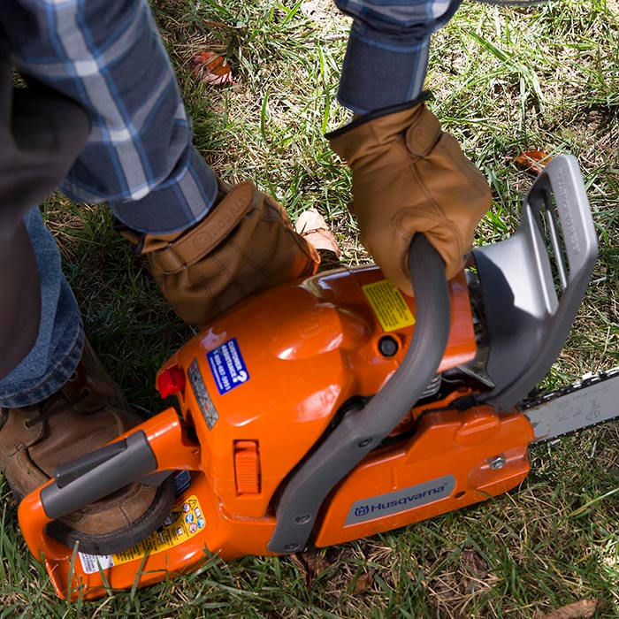
Front Handle

Slide 8
Rear Hand Guard

Slide 9
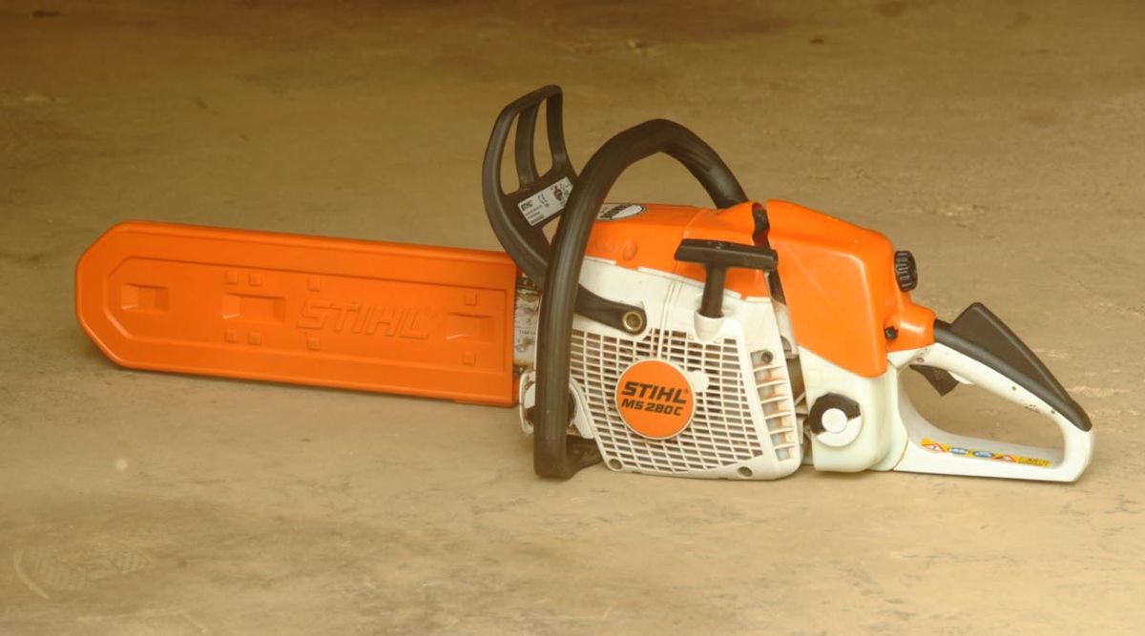
Safety Switch

Slide 10
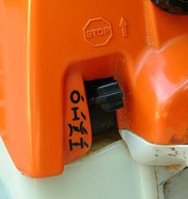
Throttle Control Lever

Slide 11
Trigger

Slide 12
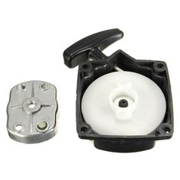
Starting Pull Handle

Slide 13
Protective Case

Slide 14
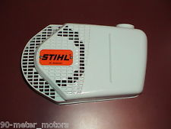
Housing

Slide 15
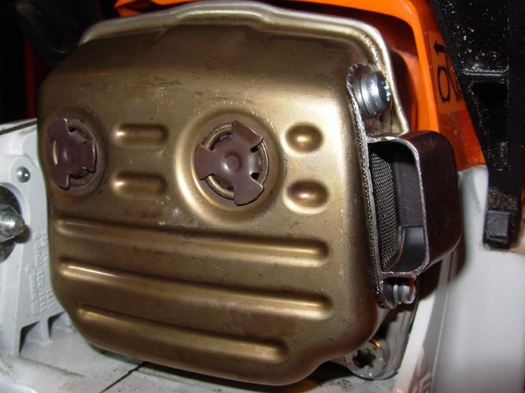
Muffler

Slide 16
Oil Cap

Slide 17
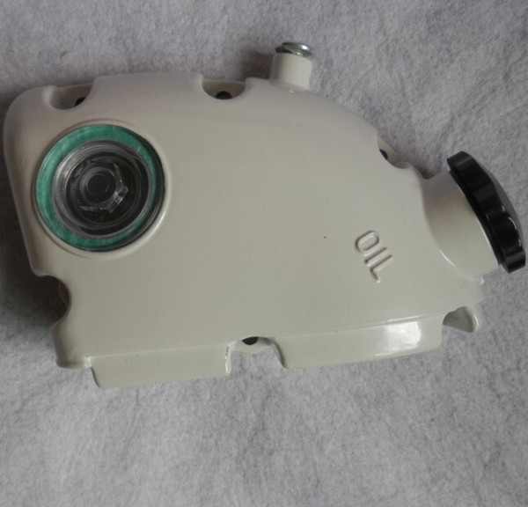
Oil Reservoir

Slide 18
Fuel Cap

Slide 19
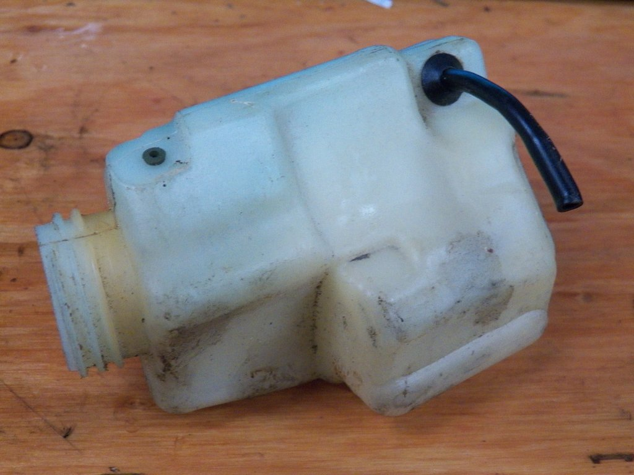
Fuel Tank

Slide 20
Air Filter Cover

Slide 21
Air Filter

